Slide 1
Data Visualization
Katherine Tansey, PhD

Slide 2
Learning Objectives
Integrate regression lines into plots to show data trends
Learn how to manipulate the scales of plots
Understand how to modify all aspects of plot layout
Comprehend quick plotting with qplot
Know how to make plots interactive

Slide 3
What we did last time
Discussed how vital it is to plot your data
Introduced to ggplot2 in R and idea of grammar of graphics
Talked about how human interpret various attributes in plots
Ways to deal with overplotting
Type of plots relates to the type of data
Made multiple plots using facet

Slide 4
Statistics

Slide 5
Already plotted this : geom_smooth
geom_smooth or stat_smooth add regression lines to scatterplots
Various types of smoothers :
loess
lm
glm
Confidence Interval is 95%
Can be turned off

Slide 6
PRACTICAL
Add smoothing lines to plots

Slide 7
stat_summary
Plot summary statistics
fun.data
fun.ymin
fun.y
fun.ymax
Variety of different summary stat functions
mean, sd, min, max
Supply your own data.frame function

Slide 8
PRACTICAL
Play with stat_summary

Slide 9
Coordinates

Slide 10
Altering the axis vs Zooming in
xlim and ylim options change the axis ranges
Change the x and y axis and alter the output
Particularly when plotting stats
coord_cartesian allows for changing of axis limits without altering plot information
Ideal to keep plots to aspect ratio of 1, however not always possible

Slide 11
PRACTICAL
Alter axis

Slide 12
Themes

Slide 13
Modify the plot
Theme refers to all the visual elements not part of the plot
Text
Axis title and text, Plot title, Legend title and text
Lines
Axis ticks and lines, grid pattern
Background
Plot, Legend, Panel
Everything can be modified

Slide 14
Inheritance of themes
There is a hierarchy to the theme elements
Can inherit from others theme elements
axis.title.x inherits from axis.title
axis.title inherits from text
There is a complex break down written here: https://www.rdocumentation.org/packages/ggplot2/versions/1.0.1/topics/theme

Slide 15
PRACTICAL
Alter themes

Slide 16
Built in themes
ggplot2 had a number of set themes already made
http://ggplot2.tidyverse.org/reference/ggtheme.html
Useful starting points
Rather than tweak everything – use a built in theme and make minor changes from there

Slide 17
PRACTICAL
Use built in themes

Slide 18
Reusing your own themes
Save theme set up as its own variable
Add the variable to ggplot2 command chain
Another option is to use theme_set ()
Set the theme at the top of the script – this will be inherited for all subsequent plots
my_fav_theme <- theme(panel.background = element_blank(),
panel.grid = element_blank(),
axis.text = element_text(color = "black", size = 14),
)
ggplot(mydata) +
geom_point(mappings = aes(x = var1, y = var2)) +
my_fav_theme

Slide 19
qplot

Slide 20
qplot for quick plotting
Same as ggplot but only one line
Less flexible with option and layering of plots
Good for quickly looking at dataset
qplot makes a guess at desired plot format based on data input
Can alter by adding geom=“desired_geom”
ggplot(movies_budget, aes(x = rating)) +
geom_histogram()
qplot( x = rating, data = movies_budget)

Slide 21
PRACTICAL
Compare qplot to ggplot

Slide 22
Interactive plots

Slide 23
Why have interactive plots
Data on website can be more informative if interactive
Example: here, here, and here
Great way for people to interact and get immediate information from plot
Journals are moving towards accepting interactive graphics

Slide 24
plotly
https://plot.ly/r/
Other interactive plotting libraries exist in R
Aligns with ggplot2 package
Still make ggplot2 plots
Some modifications to make them interactive

Slide 25
PRACTICAL
Make interactive plots

Slide 26
Putting it all together

Slide 27
PRACTICAL
Putting it all together

Slide 28
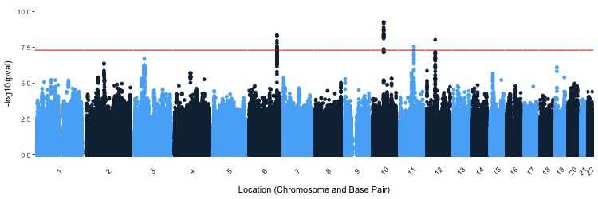
Revisit this plot
From data from here : https://www.med.unc.edu/pgc/results-and-downloads

Slide 29
PRACTICAL
Putting it all together

Slide 30
Try to recreate this plot & make it interactive
Data from Supplementary Table 3: https://www.ncbi.nlm.nih.gov/pmc/articles/PMC5357816/

Slide 31
Wrapping Up

Slide 32
Key Points
Easy to add regression lines to plots
Every aspect of plots layout can be modified which is a LOT of things
qplot can be used to make plots more quickly
Interactive plots can enhance a viewers experience
Easy-ish to make using plot.ly package

Slide 33
Further Reading
ggplot2 reference page : http://ggplot2.tidyverse.org/reference/
Cookbook for R graphics : http://www.cookbook-r.com/Graphs/
plot.ly : https://plot.ly/ggplot2/

Slide 34
Next time
Making Apps with R in Shiny
https://shiny.rstudio.com/
https://shiny.rstudio.com/gallery/

